Slide 1
Topic: Fuzzy Technique
Fuzzy sorting of intervals.
Consider the problem in which we do not know the numbers exactly. Instead, for each number, we know an interval on the real line to which it lies. As the intervals overlap more and more, the problem of fuzzy-sorting the intervals becomes progressively easier. The algorithm should take advantage of such overlapping, to the extent that it exists.
Using Fuzzy Sets.
Words like young, tall, good or high are fuzzy. There is no single quantitative value which defines the term young. The word “fuzzy” means “vagueness (ambiguity)”. Fuzziness occurs when the boundary of a piece of information is not clear-cut. Human thinking and reasoning (analysis, logic, interpretation) frequently involved fuzzy information.
Fuzzy rules are useful for modeling human thinking, perception (Opinion, view) and judgment.

Slide 2
Example:
Use colour to categorize fruit into three groups: verdant, half-mature and mature.
Observations at various stages of maturity led to the conclusions:
A verdant fruit is green.
A half mature fruit is yellow.
A mature fruit is red.
The colour is a vague description and has to be expressed in fuzzy format.
Using Fuzzy Techniques for intensity.
Intensity transformation and spatial filtering techniques for image enhancement uses the fuzzy rule-based logic. An enhancement technique that uses the various combinations of compound propositions for the fuzzy IF-THEN rules, considering features like image brightness and histogram, that improves the quality of degraded, and provides a real-world approach to image enhancement. The image preprocessing extracts the fuzzy properties corresponding to image pixels.

Slide 3
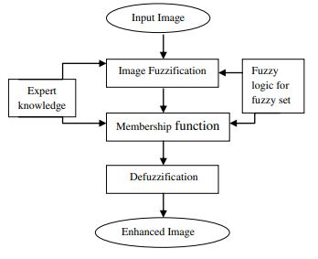
If a pixel is dark, Then make it darker.
If a pixel is gray, Then make it gray.
If a pixel is bright, Then make it brighter.
Fuzzy enhancement scheme

Slide 4
Fuzzy logic technique
Fuzzy logic has two different meanings. In a narrow sense, fuzzy logic is a logical system, which is an extension of multivalued logic. However, in the broader sense, Fuzzy Logic (FL) is almost synonymous with the theory of fuzzy sets. This theory relates to classes of objects with unsharp boundaries in which membership is a matter of degree.
Fuzzy Inference system
The fuzzy inference system can be referred to as the critical unit of the fuzzy logic system. Its primary function is based upon decision making. The rules which it follows is "IF <_condition_>THEN", which is connected through "OR" or "AND".
Let's take an example, if one condition is satisfied, then the rule is applicable. Now take the example of two rules which are applicable or suppose two situations are applicable, and you must draw the decision, keeping in mind both. Here the work of connectors come. We will be using connectors for implementing 2 rules or conditions simultaneously.

Slide 5
Image Processing using Fuzzy Logic
First, let us understand what image processing means that it is a process to perform specific techniques on an image, to get an enhanced image, or to extract some useful information from it. We can even consider it as a type of signal processing in which input is an image, and output may be image or characteristics/features associated with that image.
In Image processing, the techniques involved use filters to enhance an image. Their main applications are to transform the contrast, brightness, resolution, and noise level of an image.
Now moving on to Image processing using Fuzzy Logic, we have used a collection of different fuzzy approaches for image processing. Fuzzy image processing is the collection of all approaches that understand, represent, and process the images, their segments, and features as fuzzy sets.

Slide 6
Fuzzification interface unit – its purpose is to convert the crisp input quantities into fuzzy quantities. The input that we will be provided to the inference system, the fuzzification unit will convert that into fuzzy quantities.
Defuzzification
After the fuzzification process is done and we receive our output, but the output received is in the form of a fuzzy set and not in numeric or crisp quantities. So, for this, we need to transform the fuzzy set into numeric value or crisp quantities.
For this purpose, we use the defuzzification process called the centroid. Through the process pf centroid, we obtain the center value of the output received in the aggregation process.

Slide 7
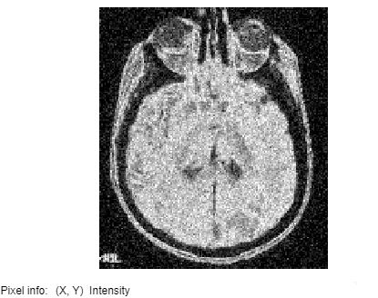
Basic steps for implementing fuzzy, rule-base system.
Fuzzification
Logic operations
Implications
Aggregation
defuzzification
Code for the program
clc
close all
clear workspace
% Coversion in gray scale
I = imread('MRI.jpg');
img2d = rgb2gray(I);
figure(1)
imshow(img2d)
[y1,x1] = size(img2d);
J = imnoise(img2d,'gaussian',0.02);
figure(2)
imshow(J);
impixelinfo;

Slide 8
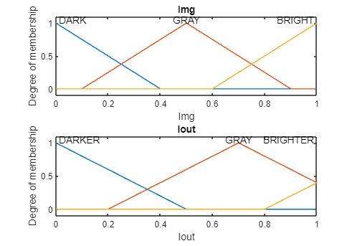
% Extrac min and max from the image array
minGrayLevel = min(J(:));
maxGrayLevel = max(J(:));
disp('minGrayLevel');
disp('maxGrayLevel');
% Array conversion
Img = im2double(J);
%Enhance
enhanceFIS = mamfis('Name','image enhancement');
enhanceFIS = addInput(enhanceFIS,[0 1],'Name','Img');
enhanceFIS = addMF(enhanceFIS,'Img','trimf',[-0.4 0 0.4],'Name','DARK');
enhanceFIS = addMF(enhanceFIS,'Img','trimf',[0.1 0.5 0.9],'Name','GRAY');
enhanceFIS = addMF(enhanceFIS,'Img','trimf',[0.6 1 1.4],'Name','BRIGHT');
enhanceFIS = addOutput(enhanceFIS,[0 1],'Name','Iout');
enhanceFIS = addMF(enhanceFIS,'Iout','trimf',[-0.5 0 0.5],'Name','DARKER');
enhanceFIS = addMF(enhanceFIS,'Iout','trimf',[0.2 0.7 1.2],'Name','GRAY');
enhanceFIS = addMF(enhanceFIS,'Iout','trimf',[0.8 1.3 1.8],'Name','BRIGHTER');

Slide 9
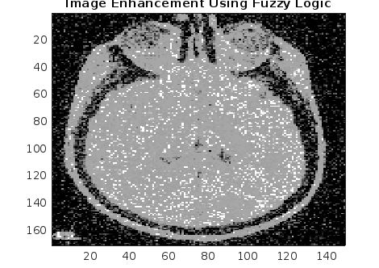
figure(3)
subplot(2,1,1)
plotmf(enhanceFIS,'input',1)
title('Img')
subplot(2,1,2)
plotmf(enhanceFIS,'output',1)
title('Iout’)
Applying fuzzy rules
r1 = "If Img is DARK then Iout is DARKER";
r2 = "If Img is GRAY then Iout is GRAY";
r3 = "If Img is BRIGHT then Iout is BRIGHTER";
enhanceFIS = addRule(enhanceFIS,[r1 r2 r3]);
enhanceFIS.Rules
Ieval = zeros(size(Img));
for ii = 1:size(Img,1)
Ieval(ii,:) = evalfis(enhanceFIS,(Img(ii,:))');
End
Plotting the enhanced image
figure(4)
image(Ieval,'CDataMapping','scaled')
colormap('gray')
title('Image Enhancement Using Fuzzy Logic')
writeFIS(enhanceFIS,'Fuzzy_Enhance')

